Slide 1


A compensation technique for accurate acceleration measurements using a UAV-deployable and retrievable sensor package
Joud Satme; Department of Mechanical Engineering Corinne Smith; Department of Mechanical Engineering Austin R.J. Downey; Department of Mechanical, Civil and Environmental Engineering Jason D. Bakos; Department of Computer Science and Engineering Nikolaos Vitzilaios; Department of Mechanical Engineering Dimitris Rizos; Department of Civil and Environmental Engineering
Methodology
Experimentation
Results and Discussion
Future work

Slide 2
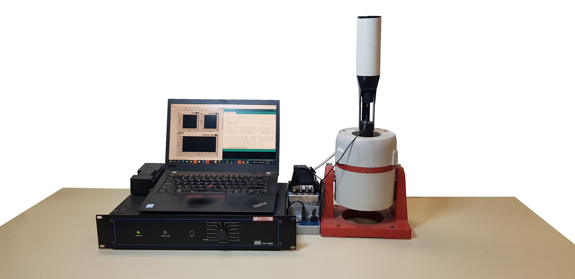
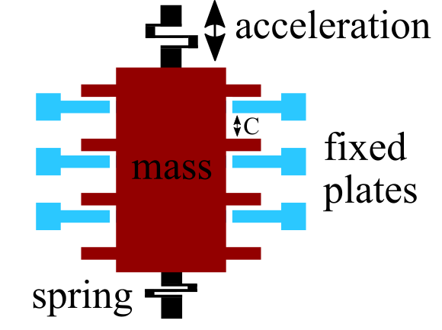
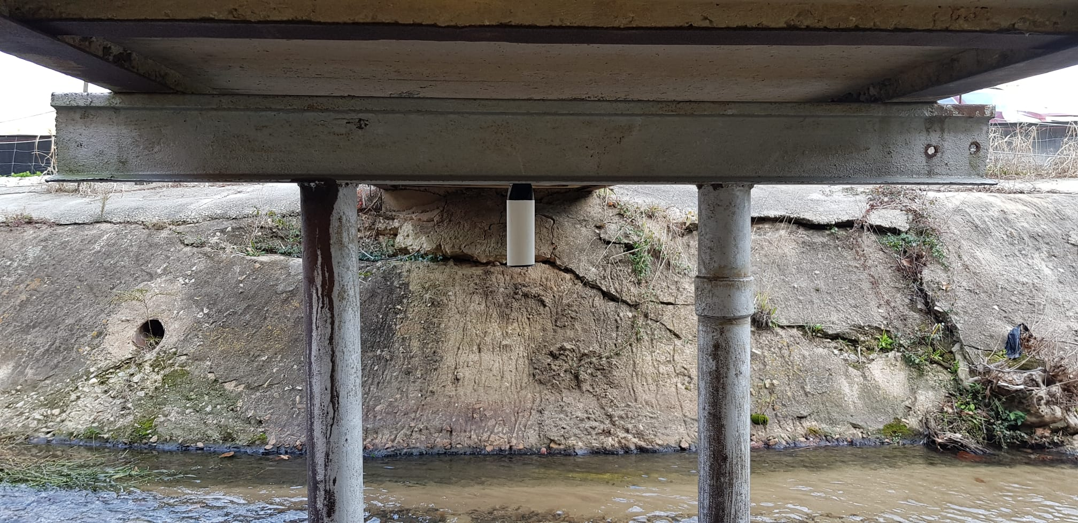
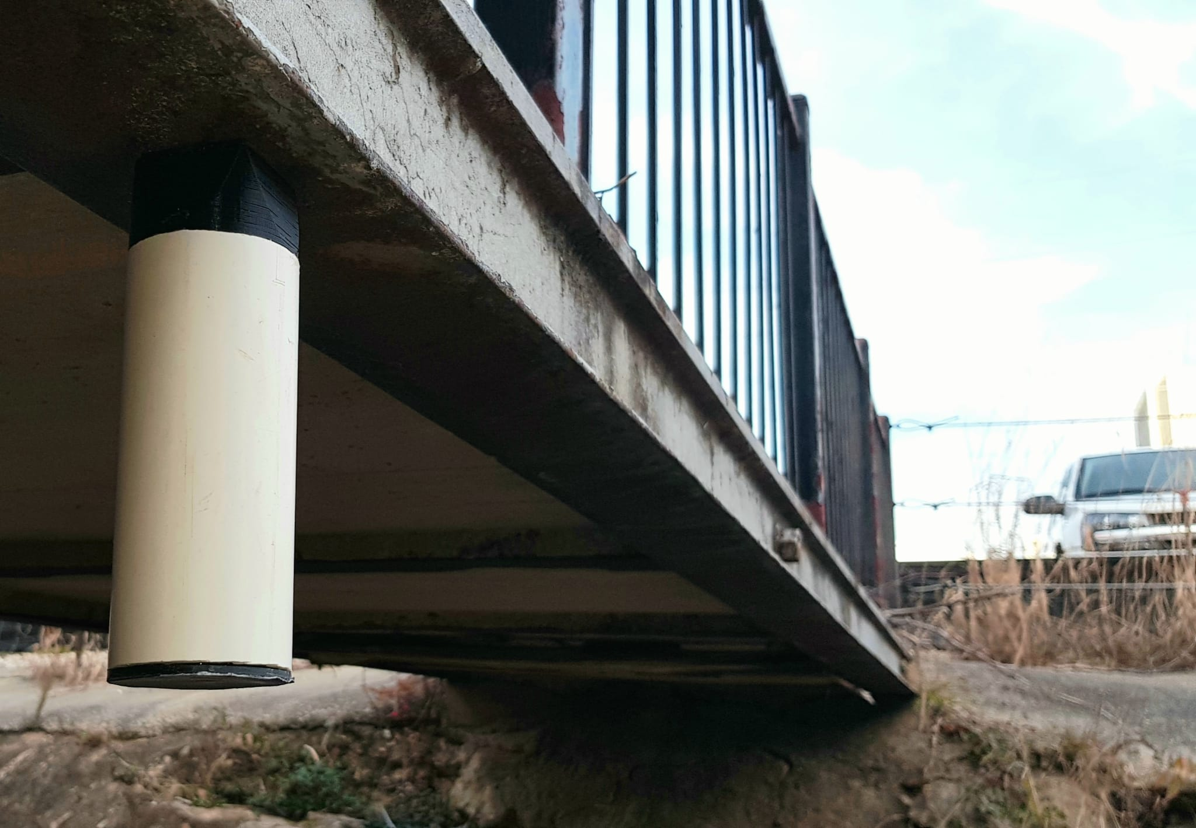
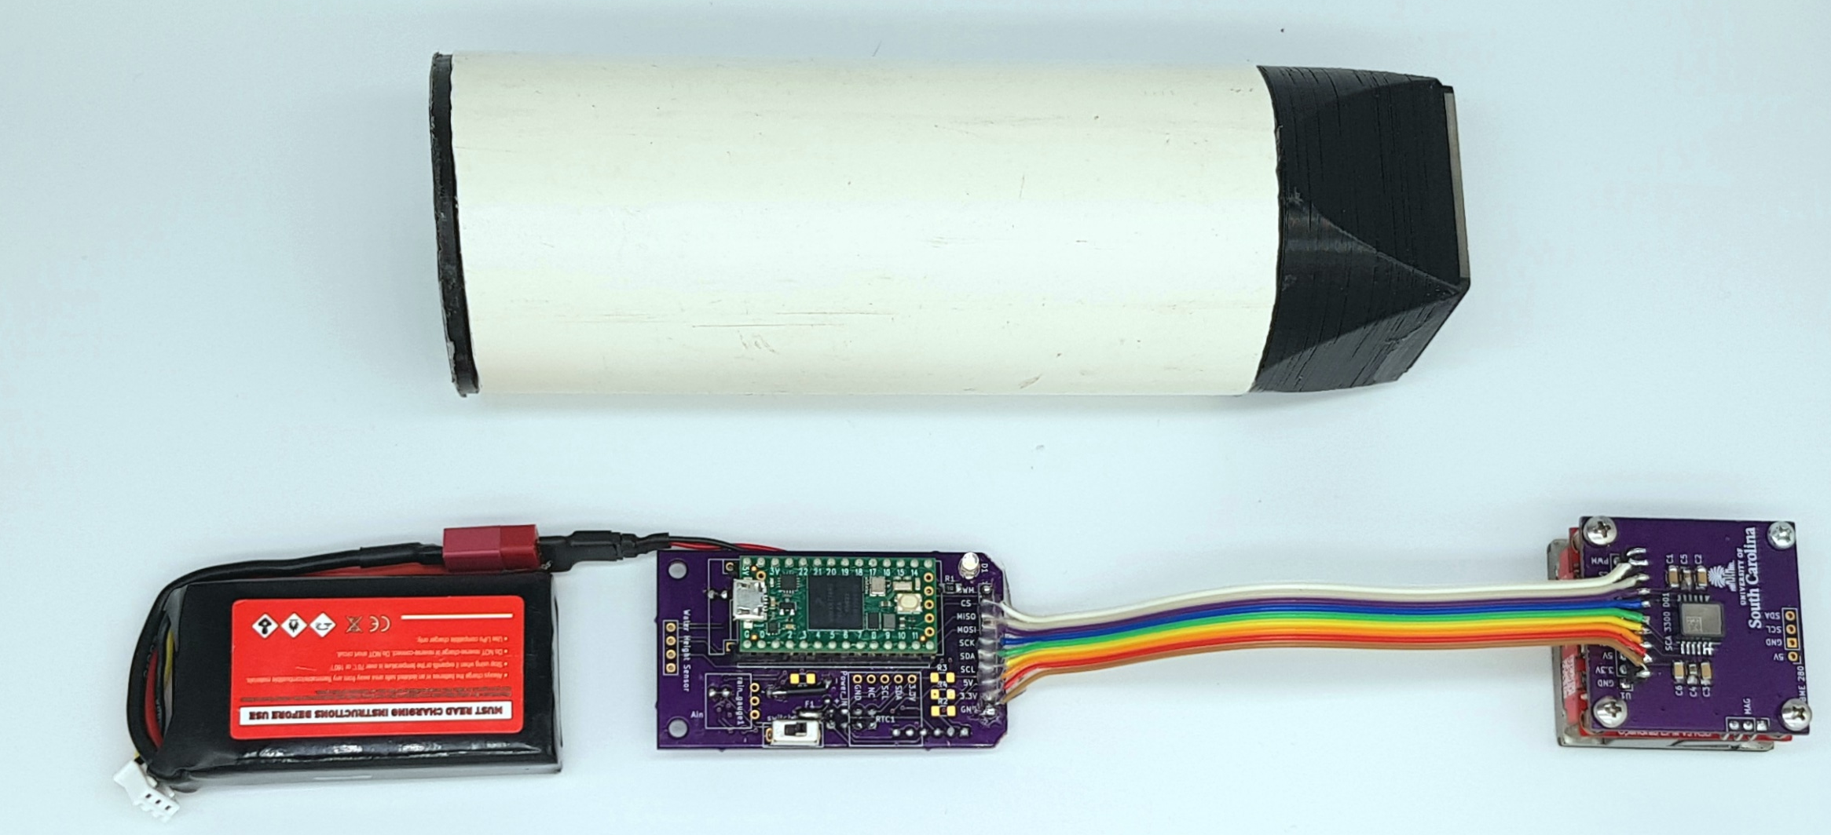
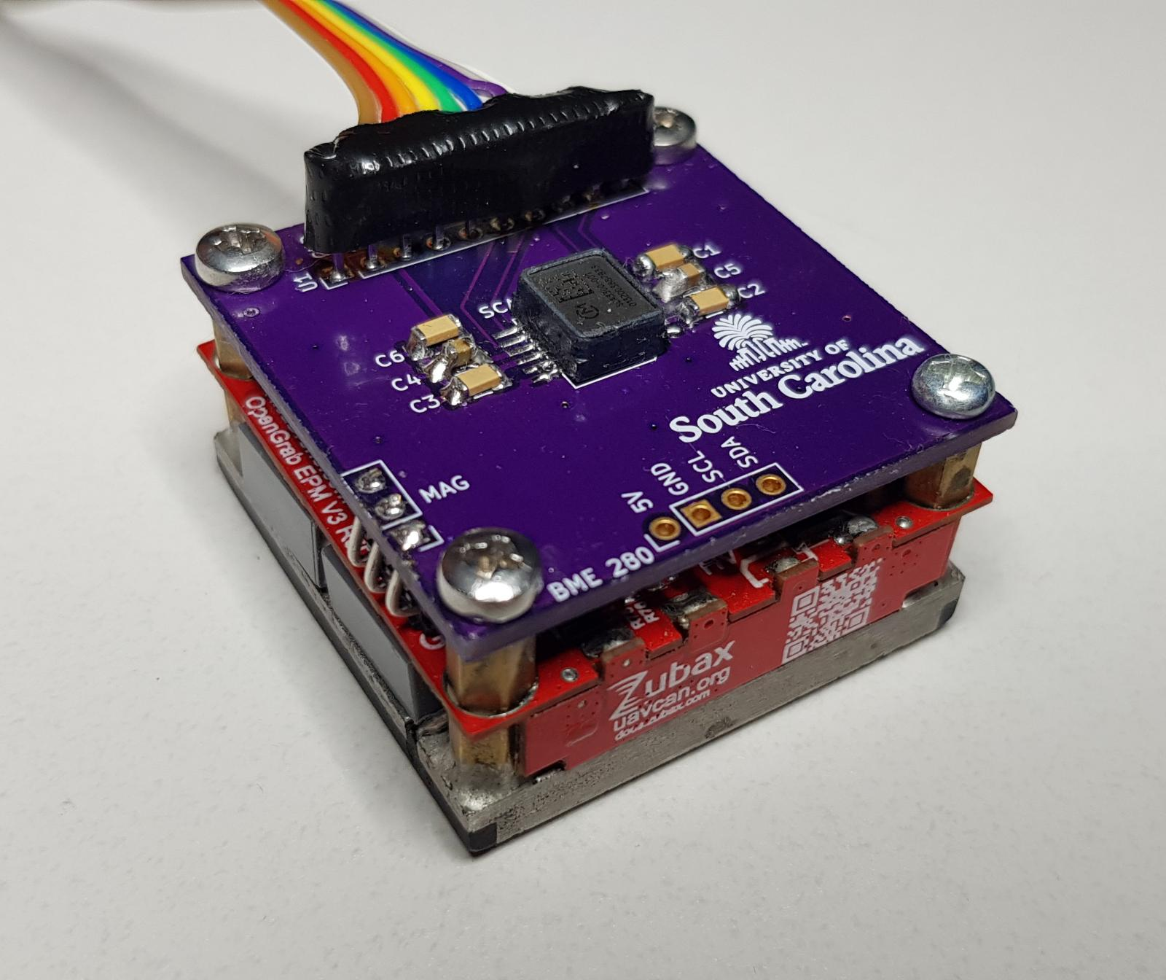
Methodology
Experimentation
Results and Discussion
Future work
Outline
Methodology:
Sensor package breakdown
Features
Hardware
Algorithm
Deployment and retrieval
Transfer function-based filter
Approach and assumptions
Model training
Experimentation:
Bench-top testing (Training)
Structure testing (Validation)
Results and Discussion:
Experimental outcomes
Findings and limitations
Future work:
Sensor improvement
Edge implementation
2

Slide 3
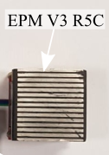
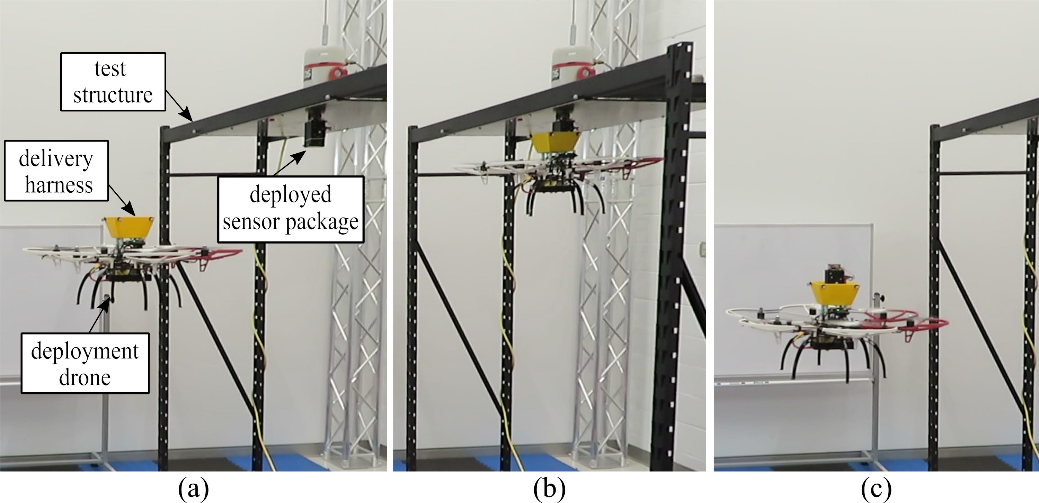
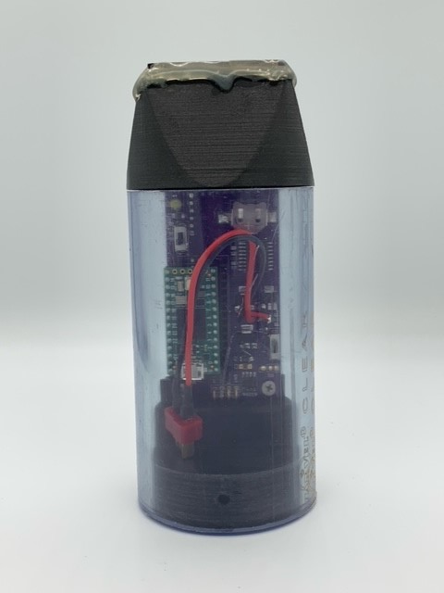
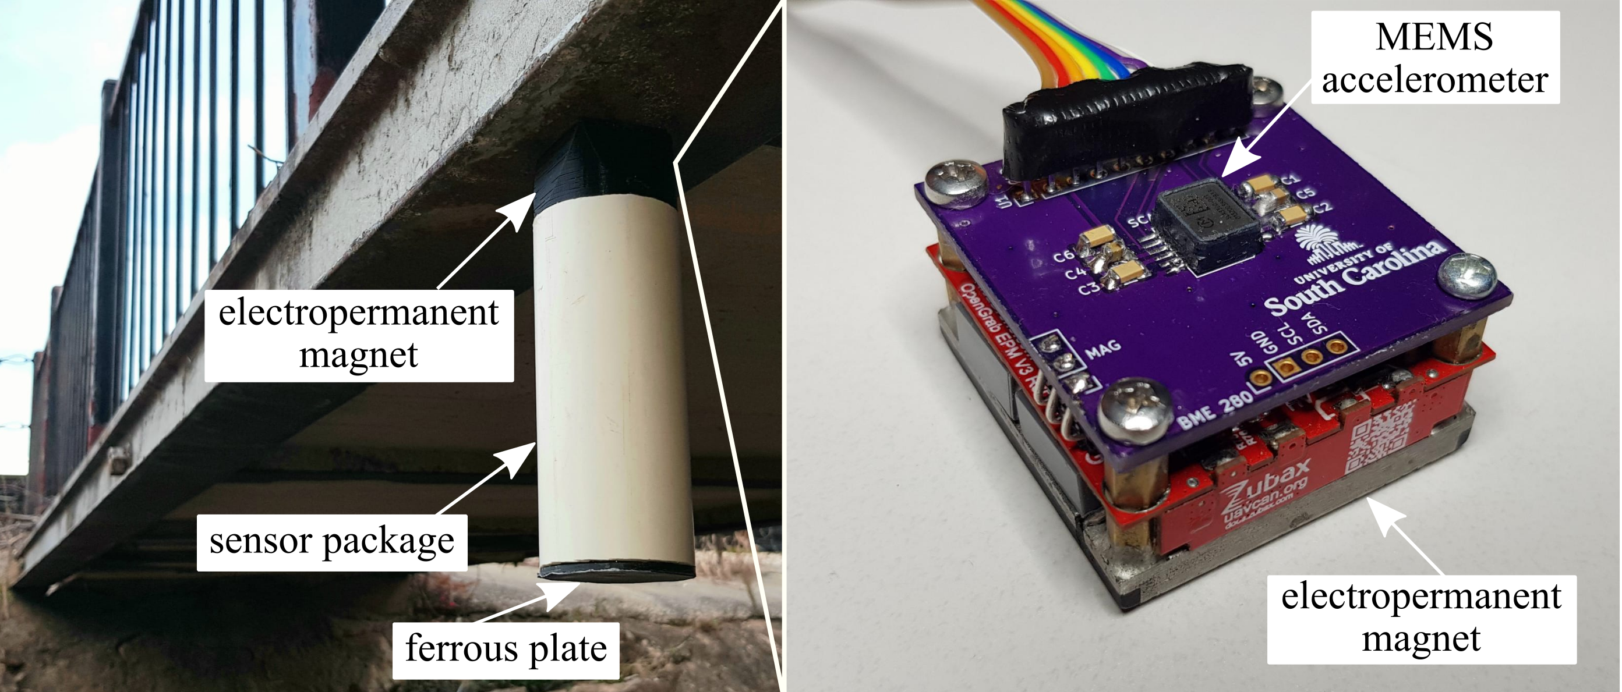
Methodology
Experimentation
Results and Discussion
Future work
Introduction
Importance of structural health monitoring.
Current systems in use and their features.
Problem statement:
Long-term data collection.
Rapid large-scale deployment.
Transmissibility losses.
Proposed approach:
Stand-alone sensor package.
UAV-delivery system.
Transfer function-based compensation method.
3

Slide 4
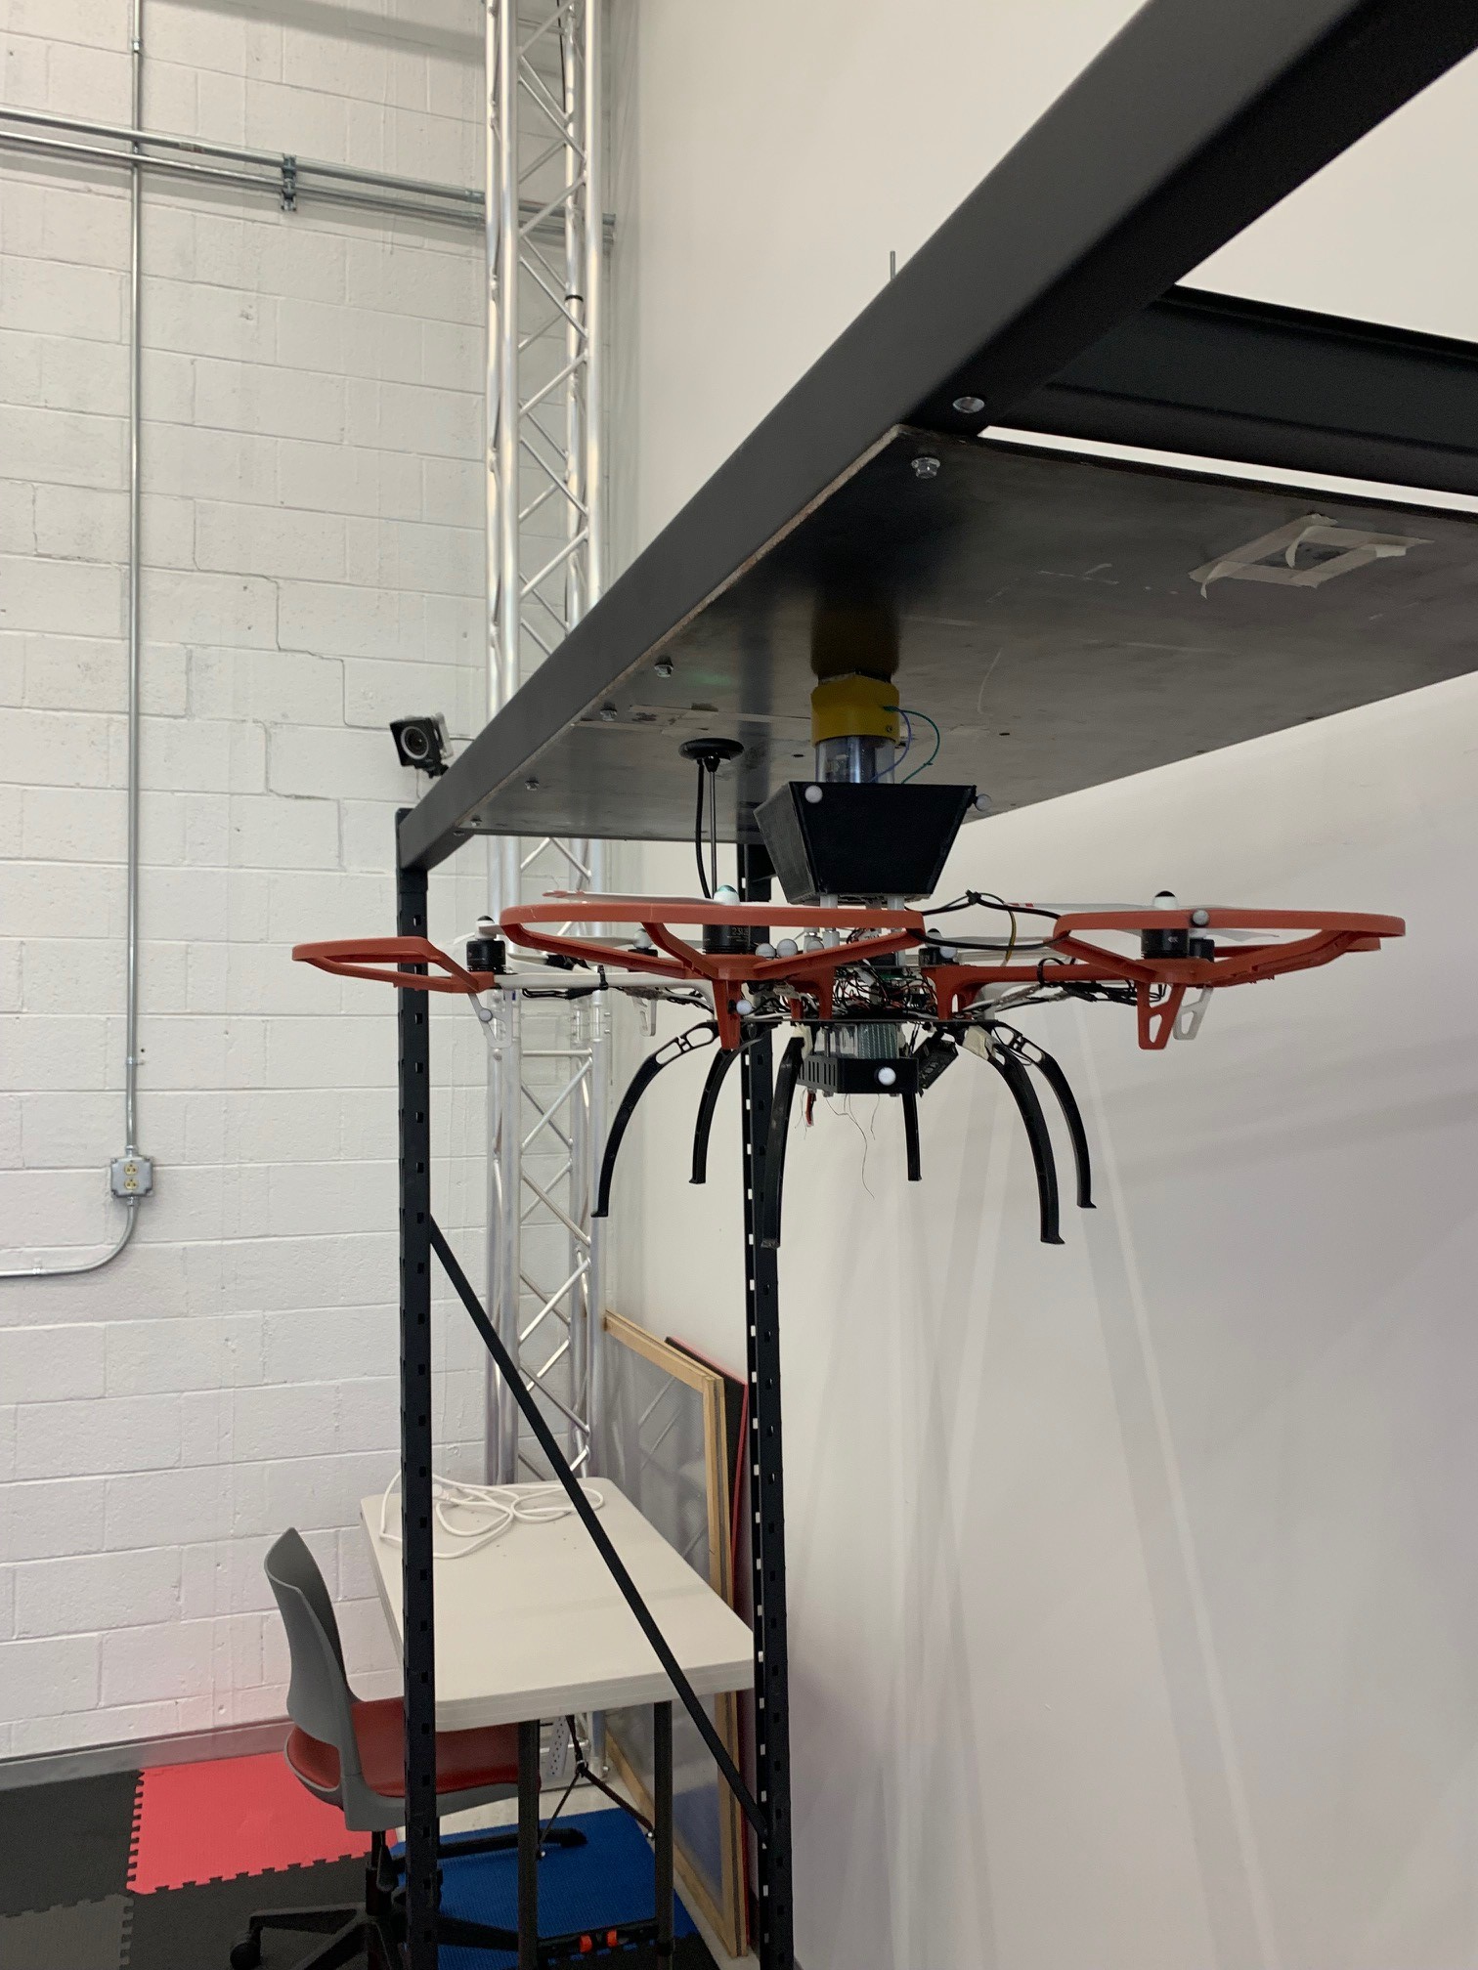
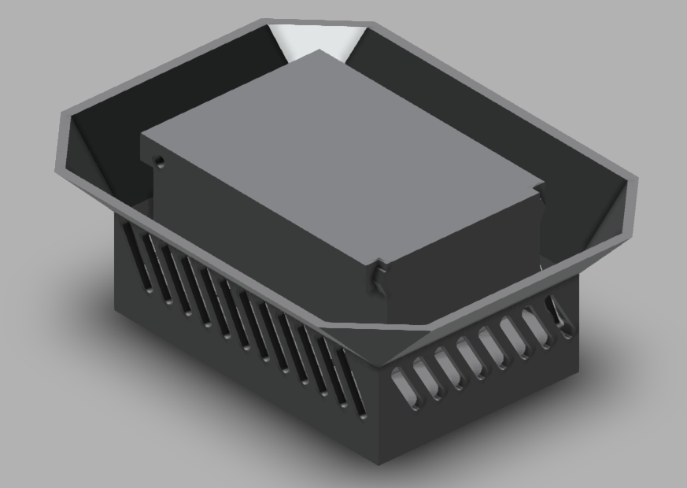
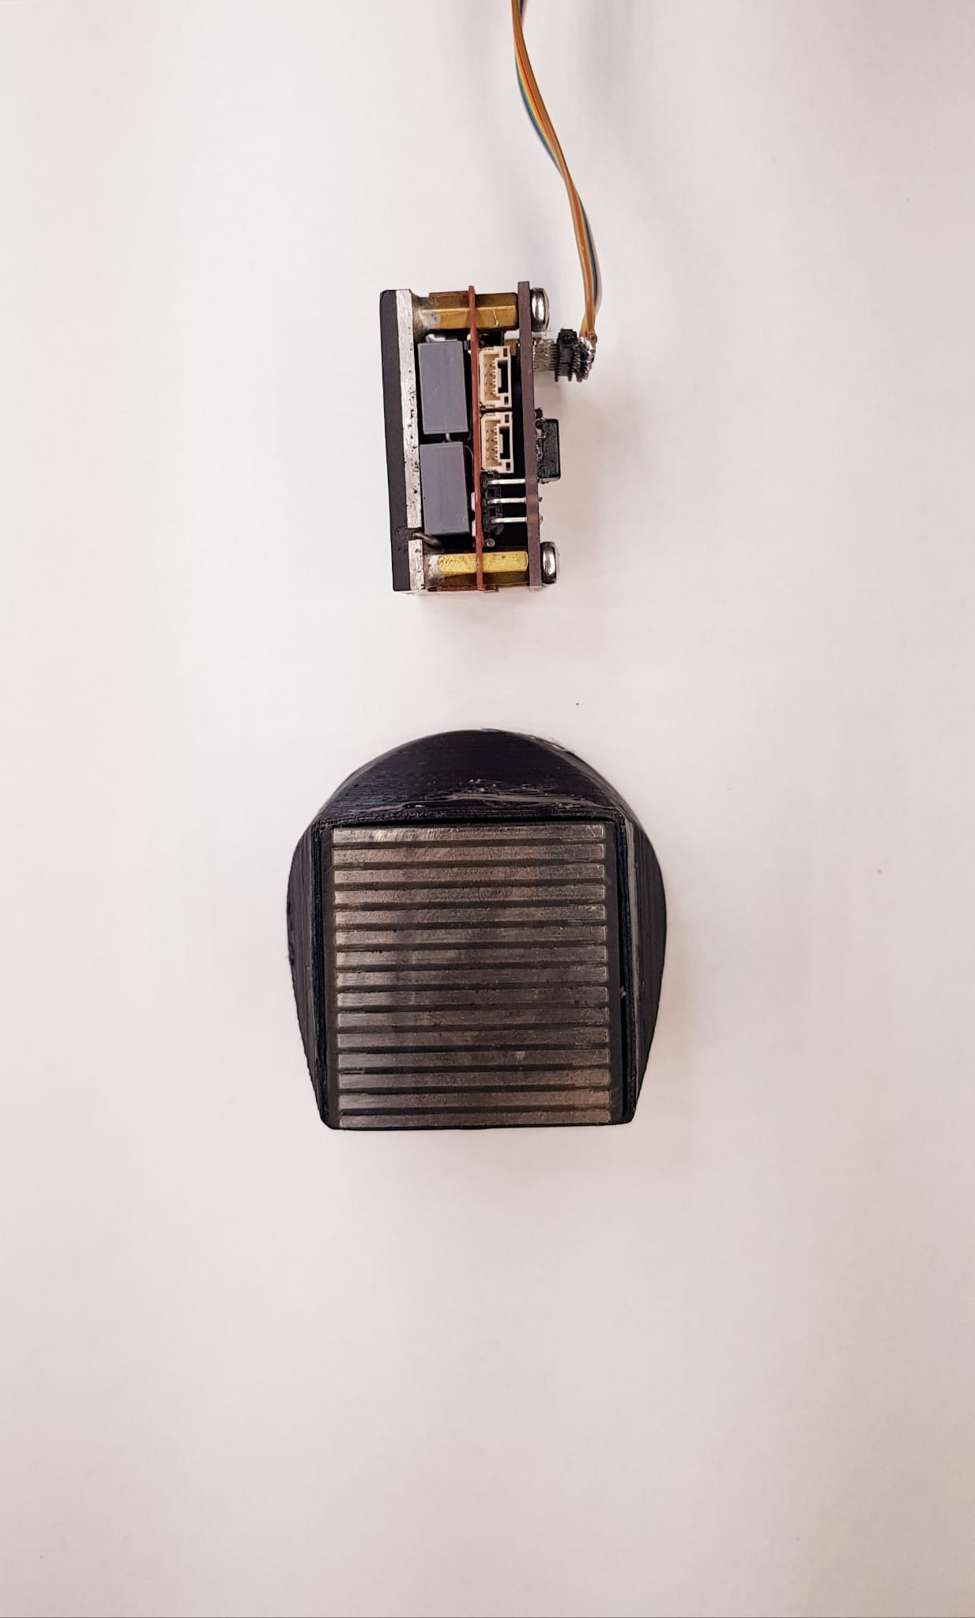
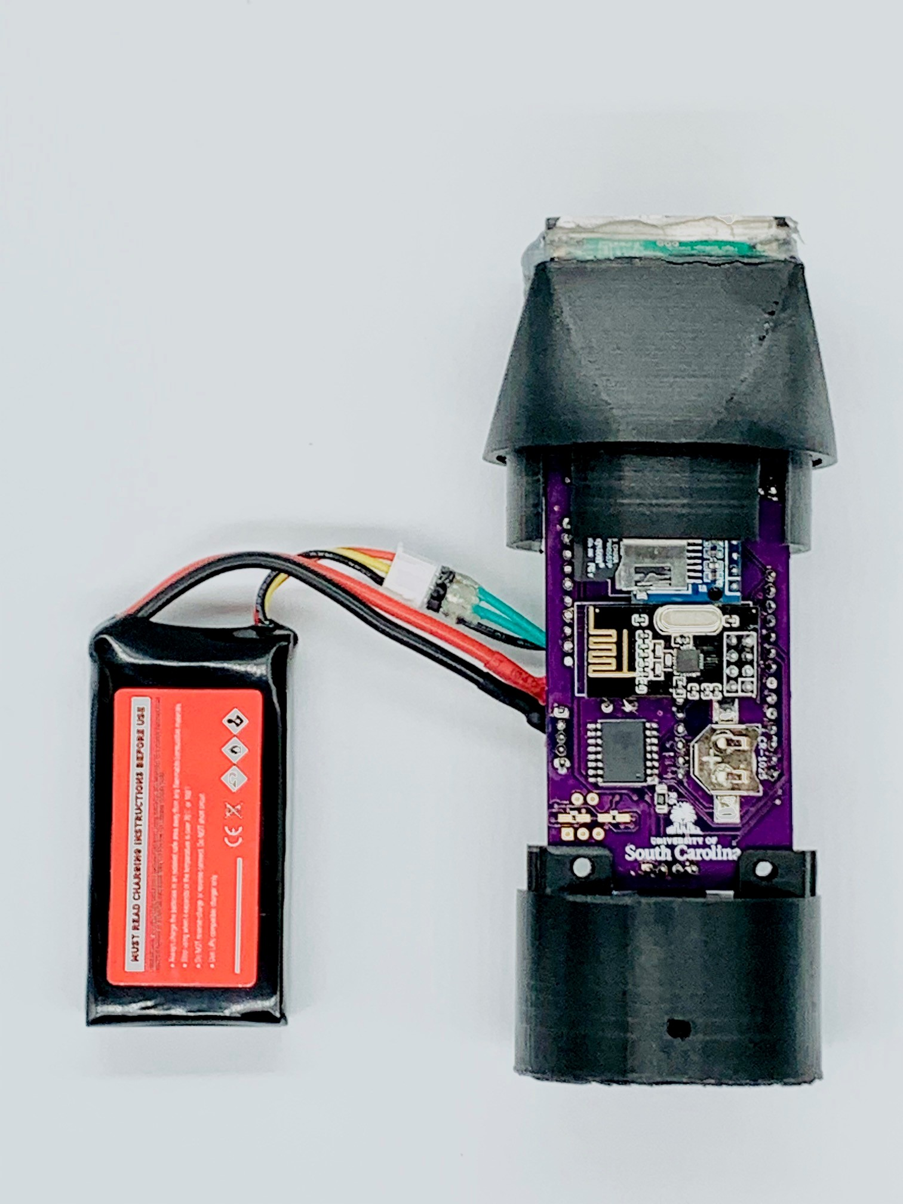
Methodology
Experimentation
Results and Discussion
Future work
Sensor package breakdown
Features:
UAV deployable sensor package designed with high mobility in mind.
Power and memory storage subsystems in anticipation of long-term deployment.
Wireless subsystem for data transmission and IO commands.
Docking subsystem utilizing electropermanent magnets.
Frame of the package designed with minimizing transmissibility losses in mind.
Maximum sampling rate 28 kS/s.
4

Slide 5
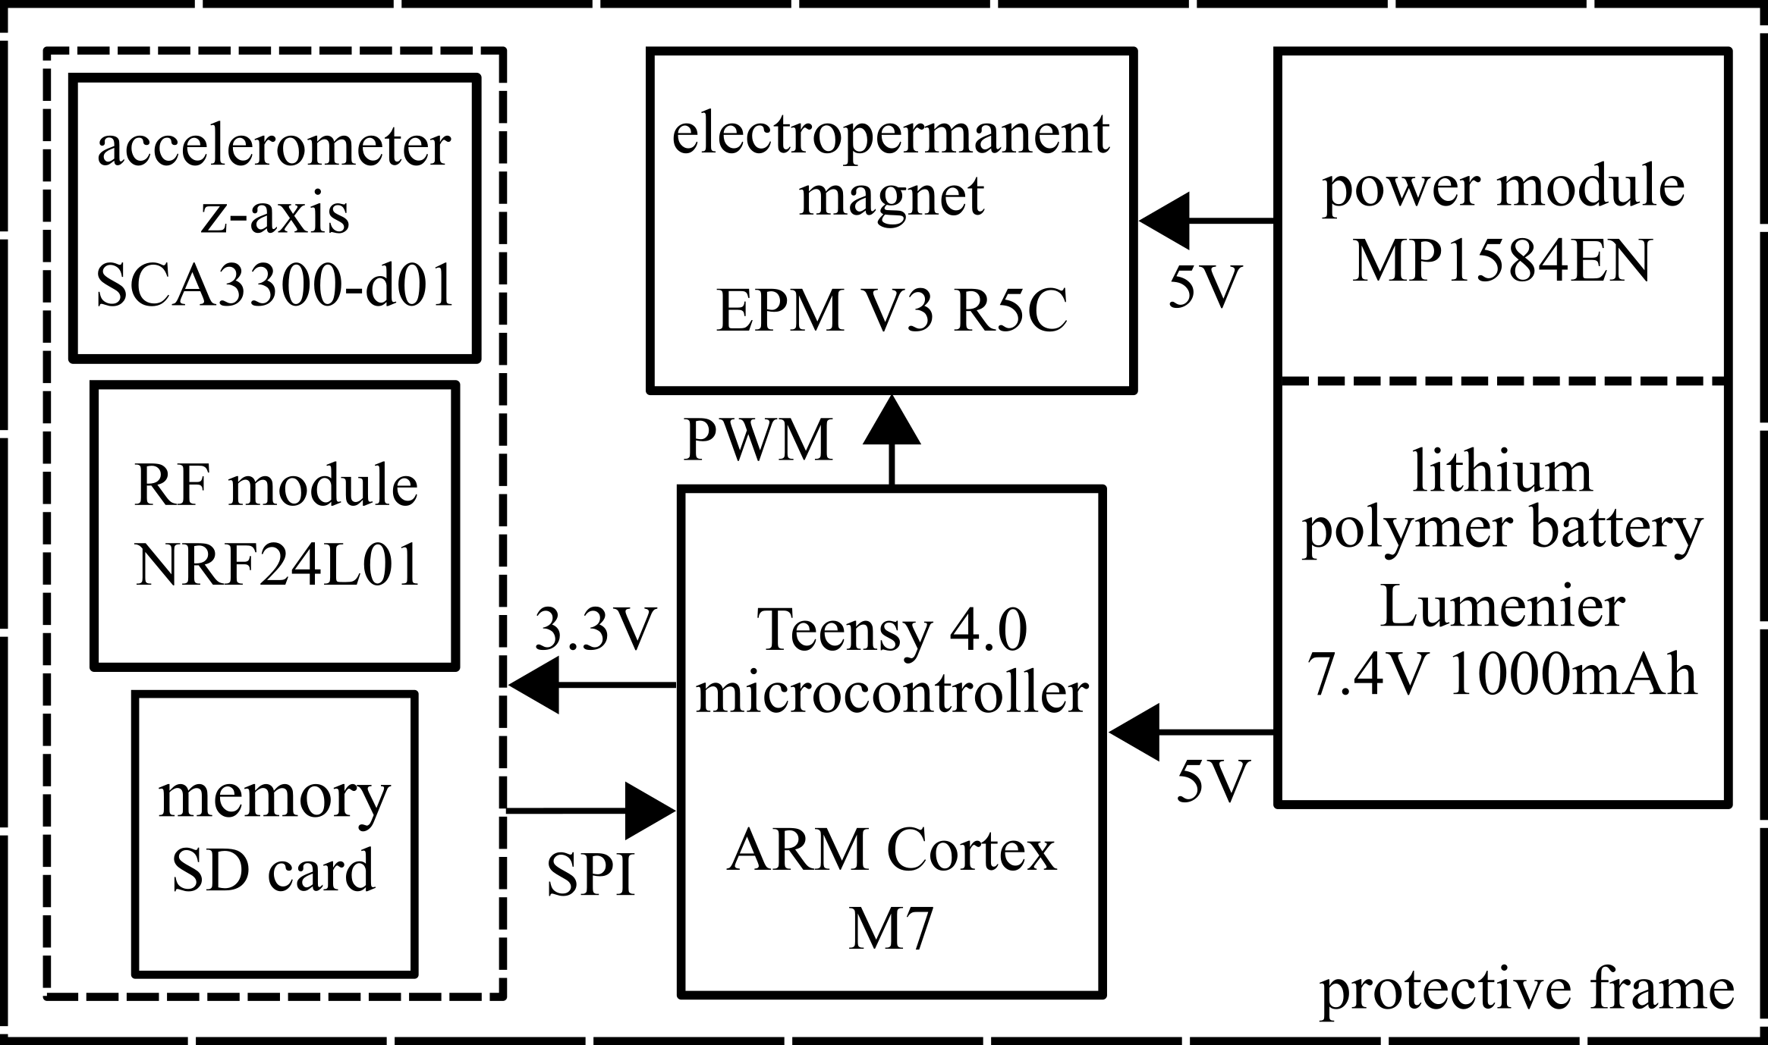
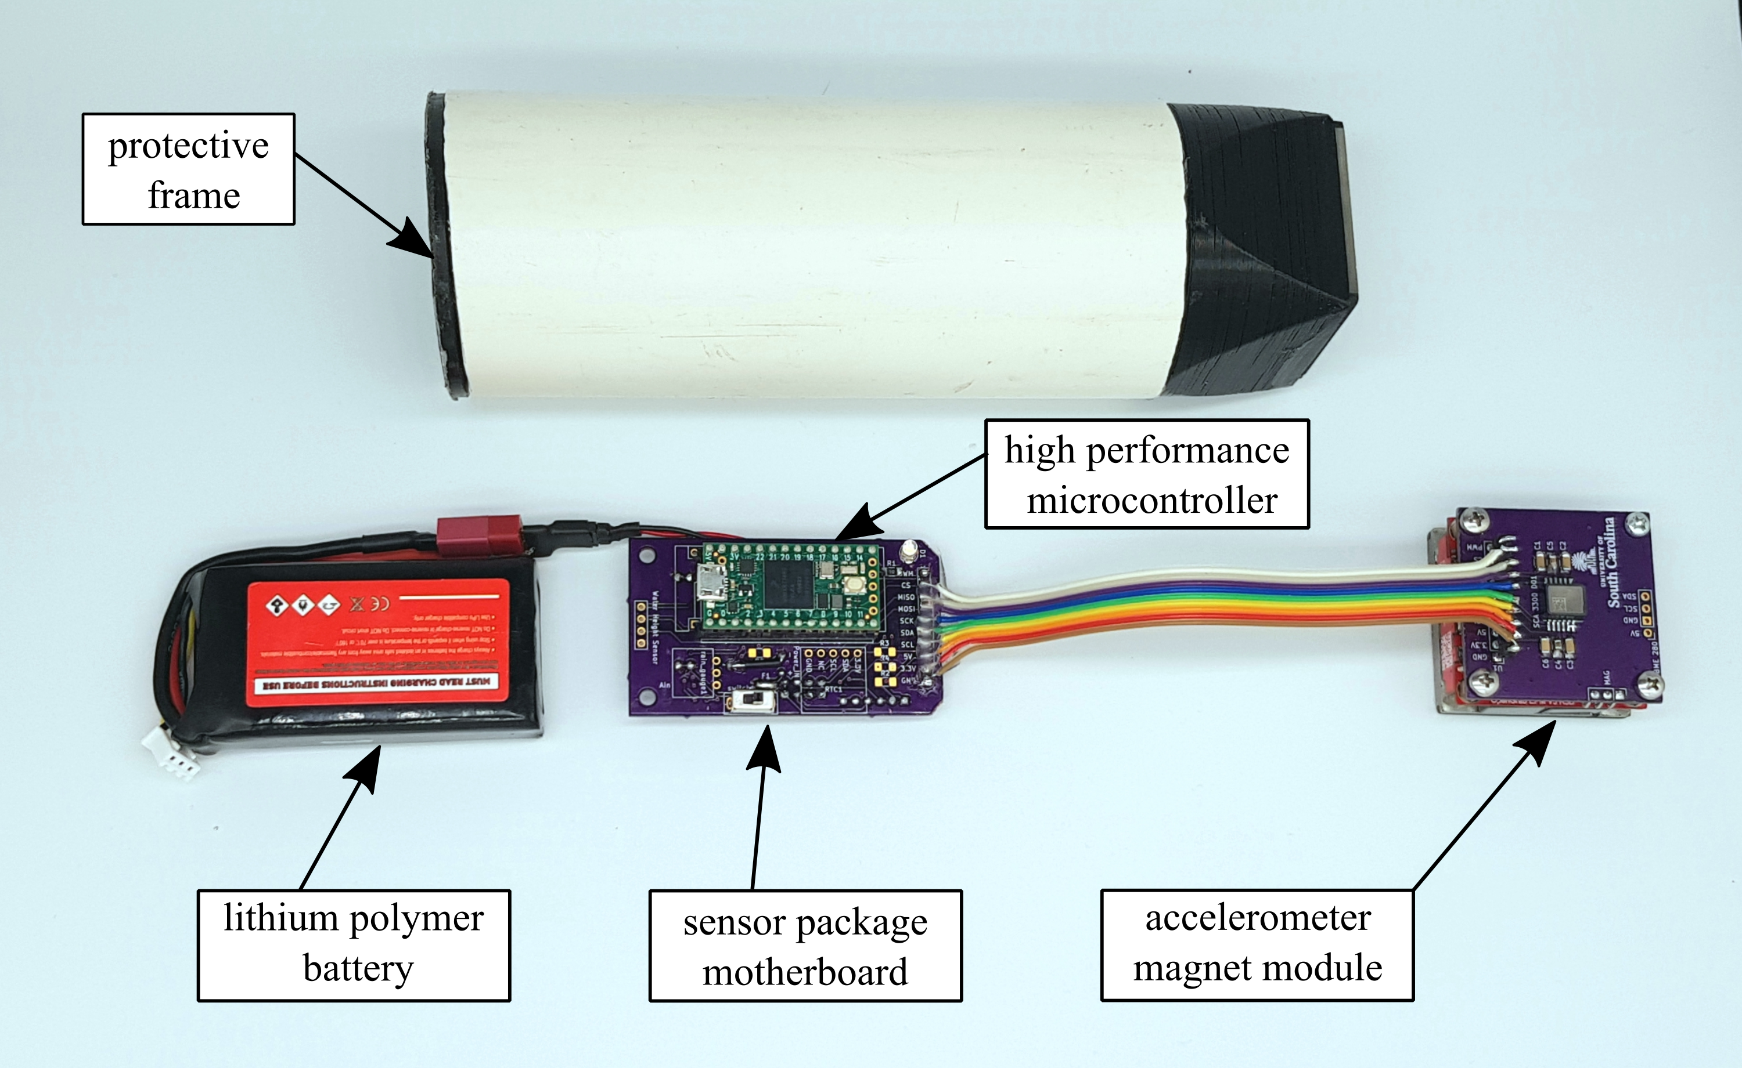
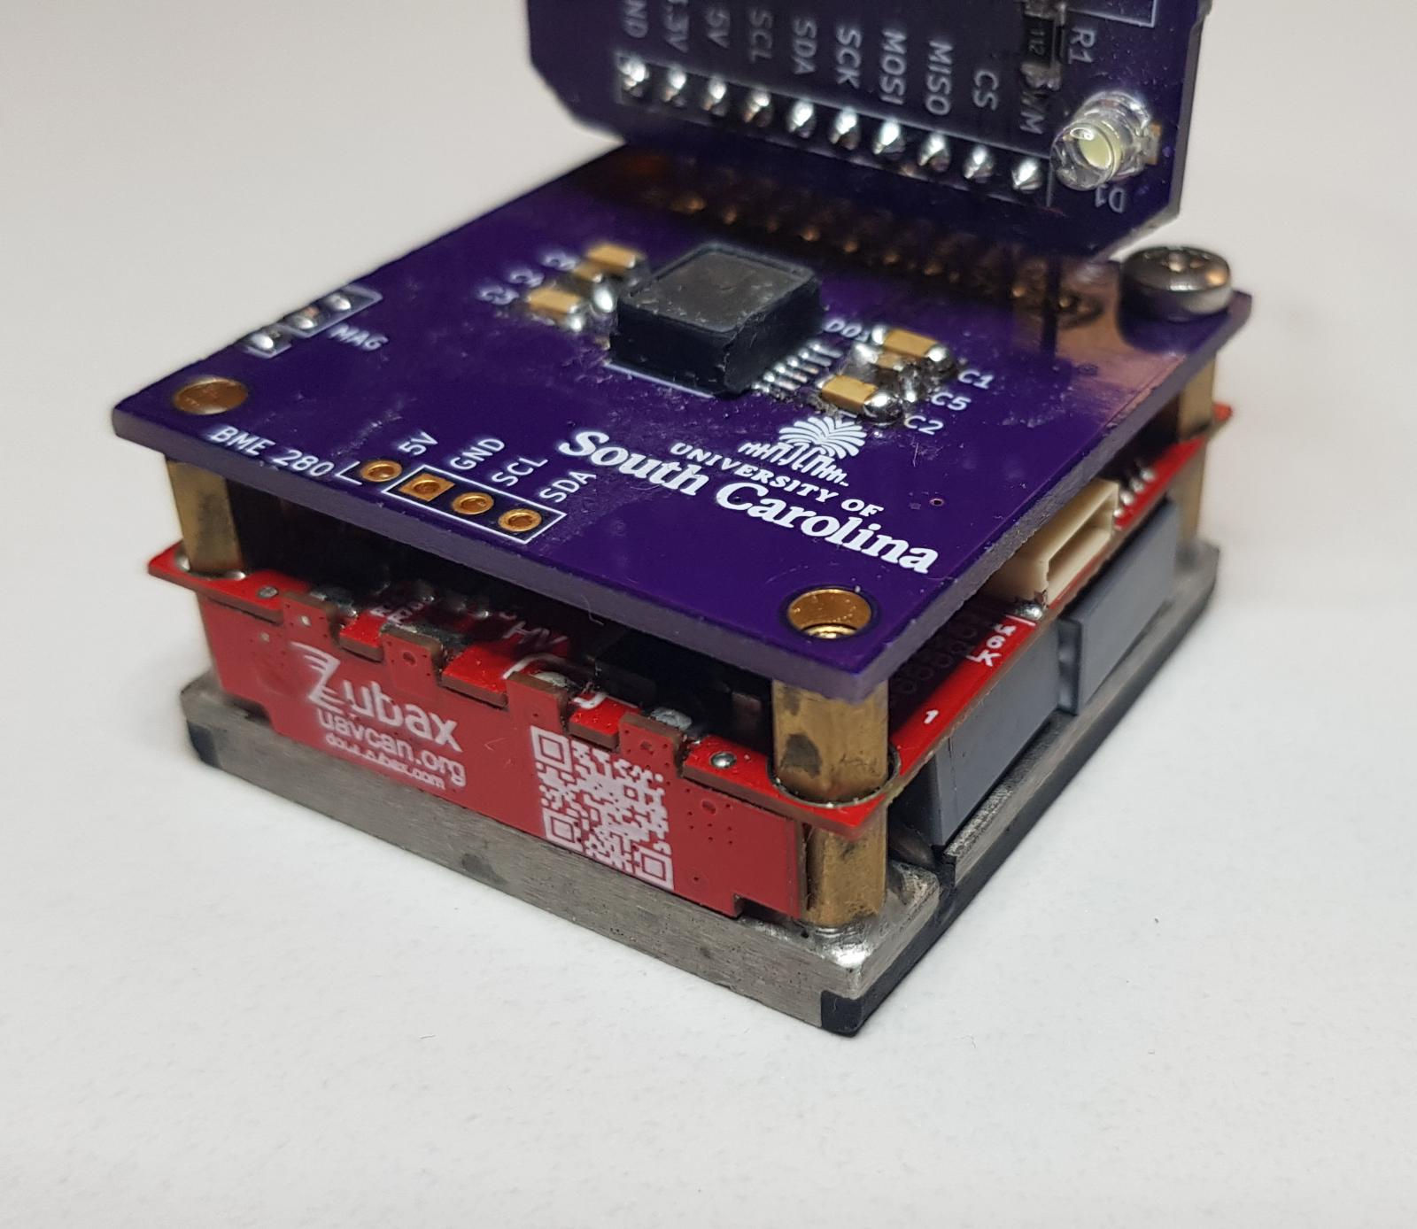
Methodology
Experimentation
Results and Discussion
Future work
Sensor package breakdown
Hardware:
Processor: ARM Cortex-M7 on Teensy 4.0 microcontroller.
SCA3300-d01 MEMS accelerometer.
EPM V3R5C electropermanent magnet.
Nonvolatile memory (SD card) for long-term storage.
Lithium polymer battery, voltage regulation and monitoring.
NRF24L01 Nordic Semiconductor wireless transceiver.
5

Slide 6
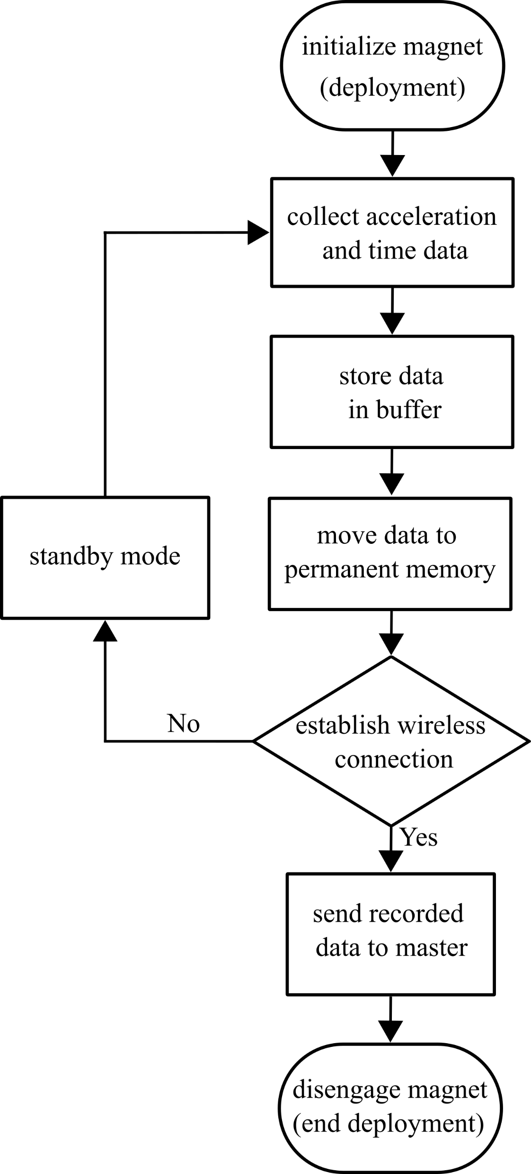
Methodology
Experimentation
Results and Discussion
Future work
Sensor package breakdown
Developed on Arduino IDE and deployed on an ARM Cortex-M7 processor.
Algorithm:
Initialize the magnet signaling start of deployment.
Acceleration data is periodically collected.
Data collected in a buffer to enable high sampling rates.
74,000 timed samples are collected then transferred onto the memory.
Code initiates standby mode which turns modules off to conserve power.
Microcontroller and wireless module remain on for communication.
User interface:
A connection is achieved over 2.4 GHz ShockBurst protocol.
User can monitor operating conditions of the sensor package.
Retrieve stored data.
Issue commands to electropermanent magnet for retrieval.
6

Slide 7
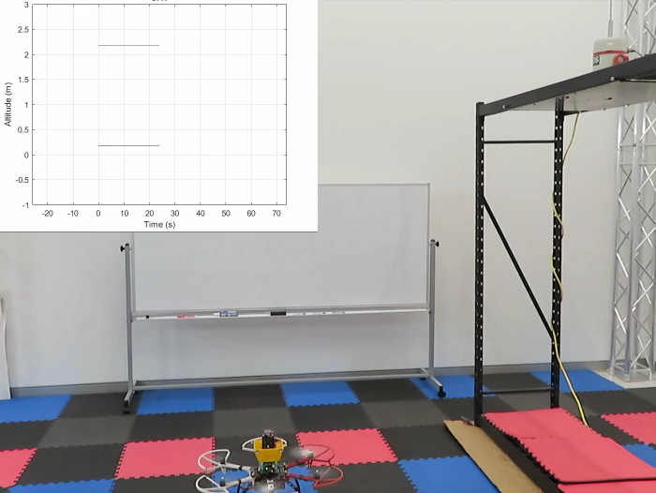
Methodology
Experimentation
Results and Discussion
Future work
Deployment and retrieval
Package is mounted onboard UAV.
Contact is established with test structure.
Electropermanent magnet on sensor package initiates.
UAV electropermanent magnet disengages.
Sensor package periodically collects data.
UAV approaches structure and establishes contact with package.
Electropermanent magnets toggle.
UAV retrieves sensor package.
7

Slide 8
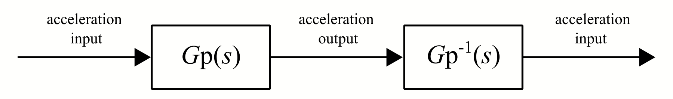
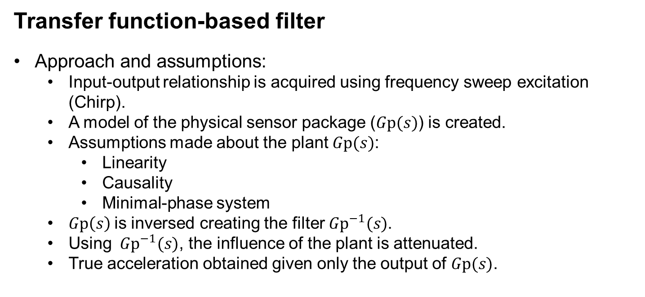
Methodology
Experimentation
Results and Discussion
Future work
Transfer function-based filter
Approach and assumptions:
Input-output relationship is acquired using frequency sweep excitation (Chirp).
A model of the physical sensor package ($Gp(s)$) is created.
Assumptions made about the plant $Gp(s)$:
Linearity
Causality
Minimal-phase system
$Gp\left(s\right)$is inversed creating the filter ${Gp}^{−1}(s)$.
Using ${ Gp}^{−1}(s)$, the influence of the plant is attenuated.
True acceleration obtained given only the output of $Gp(s)$.
8

Slide 9
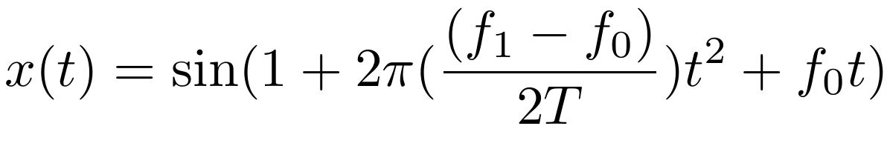
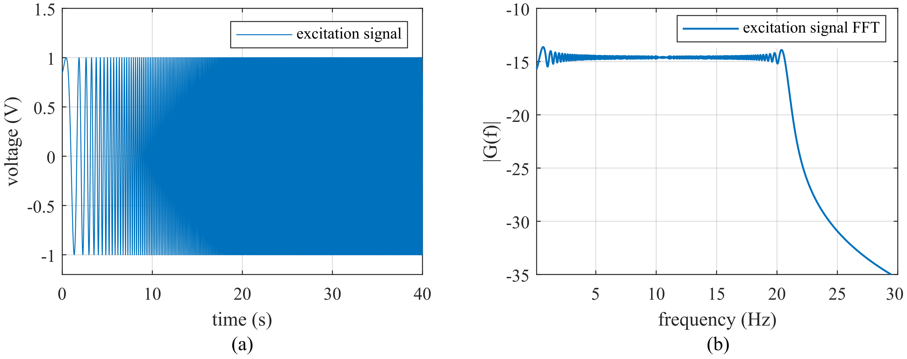
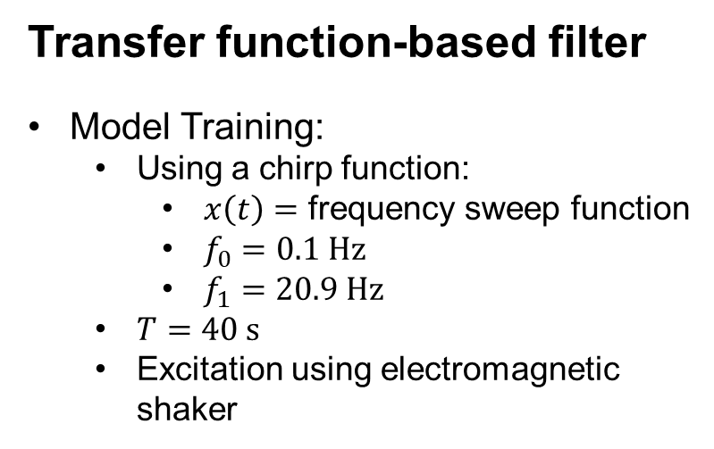
Methodology
Experimentation
Results and Discussion
Future work
Transfer function-based filter
Model Training:
Using a chirp function:
$x\left(t\right)=$ frequency sweep function
$f_{0}=0.1 Hz$
$f_{1}=20.9 Hz$
$T=40 s$
Excitation using electromagnetic shaker
9

Slide 10
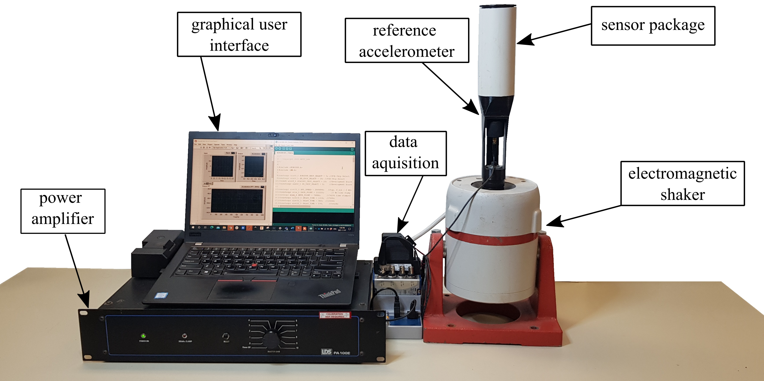
Methodology
Experimentation
Results and Discussion
Future work
Bench-top testing (Training)
Experimental parameters:
Bandwidth of interest: 0.1-20.9 Hz
Excitation source: Electromagnetic shaker
Reference accelerometer: Piezoelectric model 393B04
Sensor package hard-wired trigger.
Sampling rate: 1600 S/s
10

Slide 11
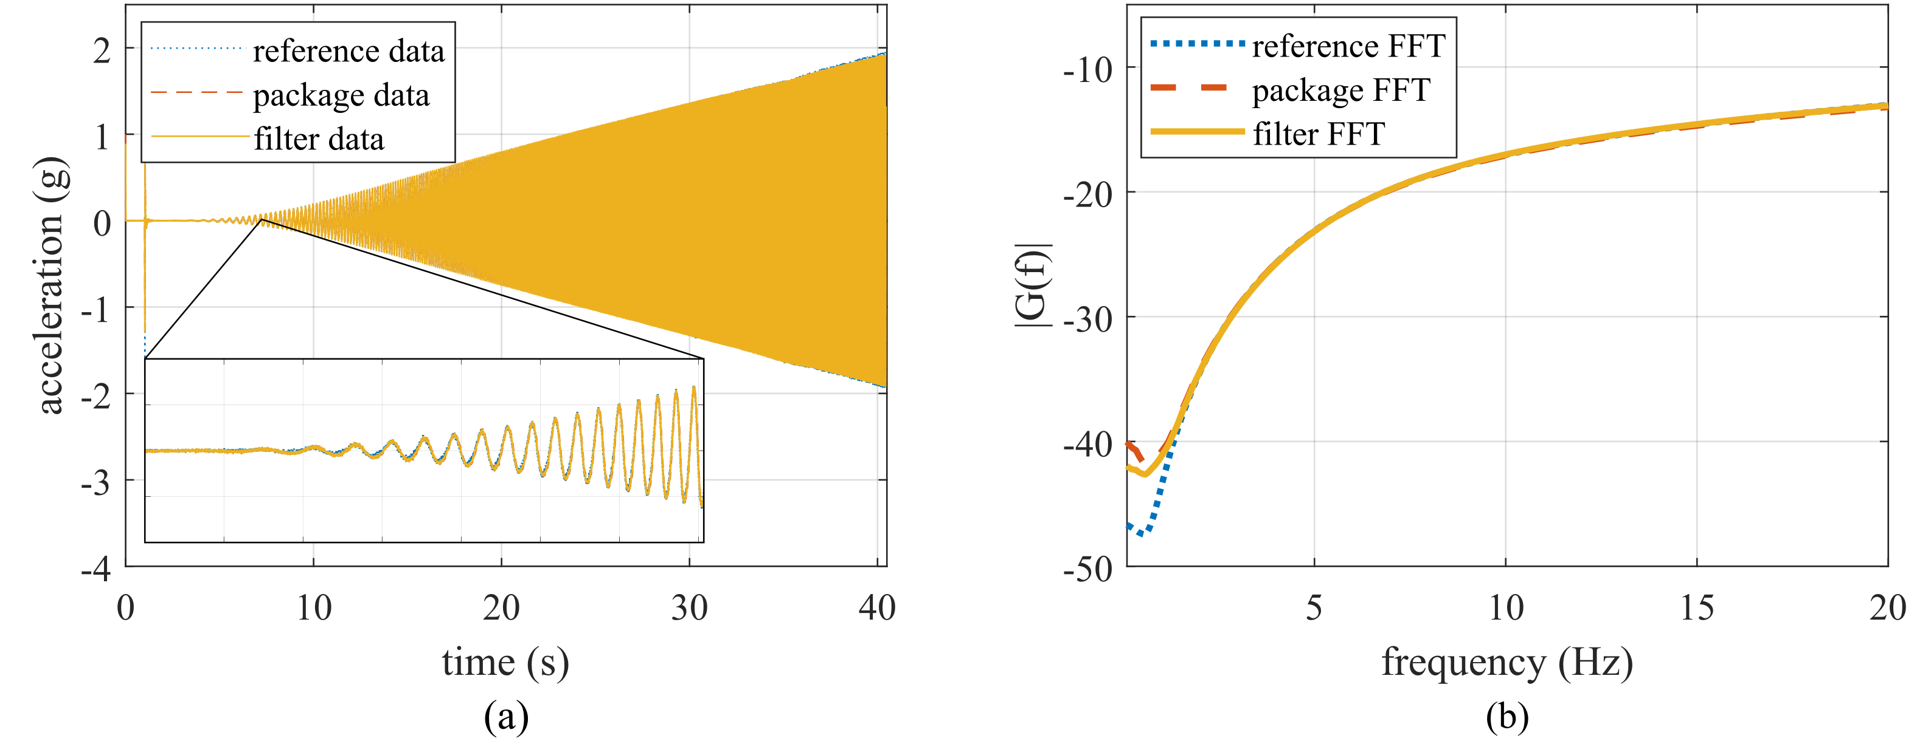
Methodology
Experimentation
Results and Discussion
Future work
Bench-top testing (Training)
Experimental procedure:
Synthesized Chirp voltage signal is fed into the shaker for excitation.
Reference accelerometer and sensor package are synchronized
Through this experiment an input-output relationship is established.
11

Slide 12
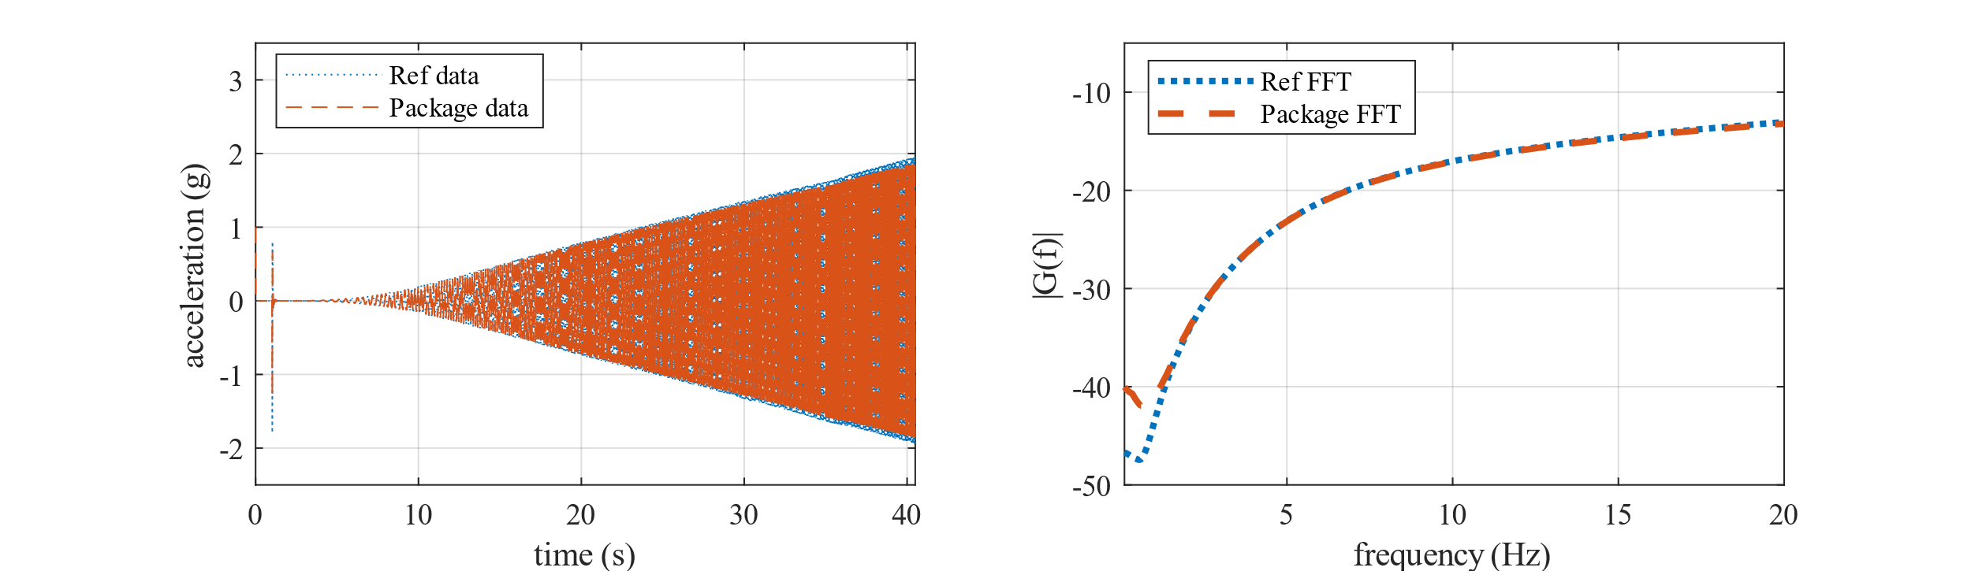
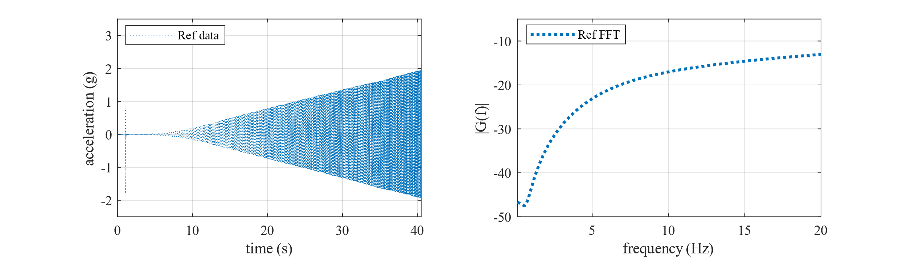
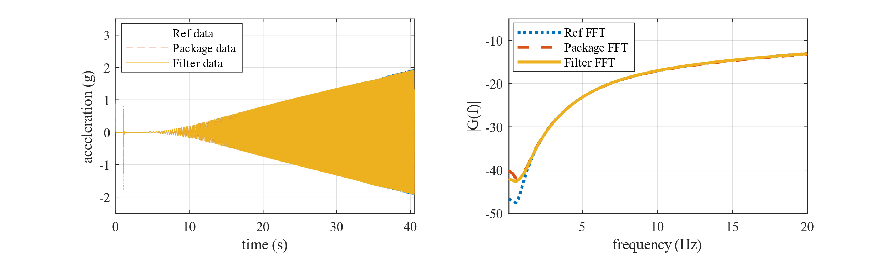
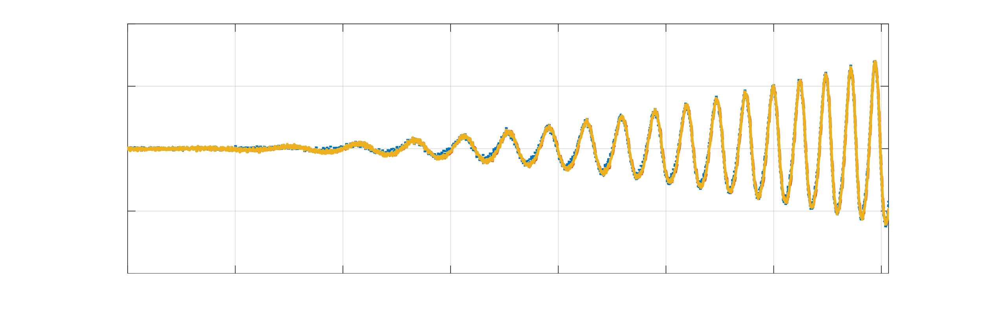
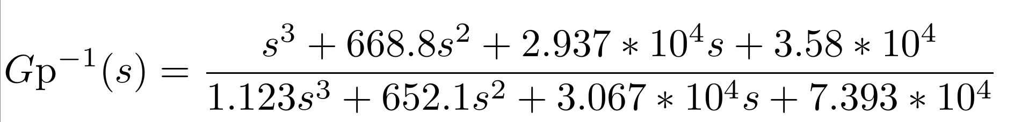
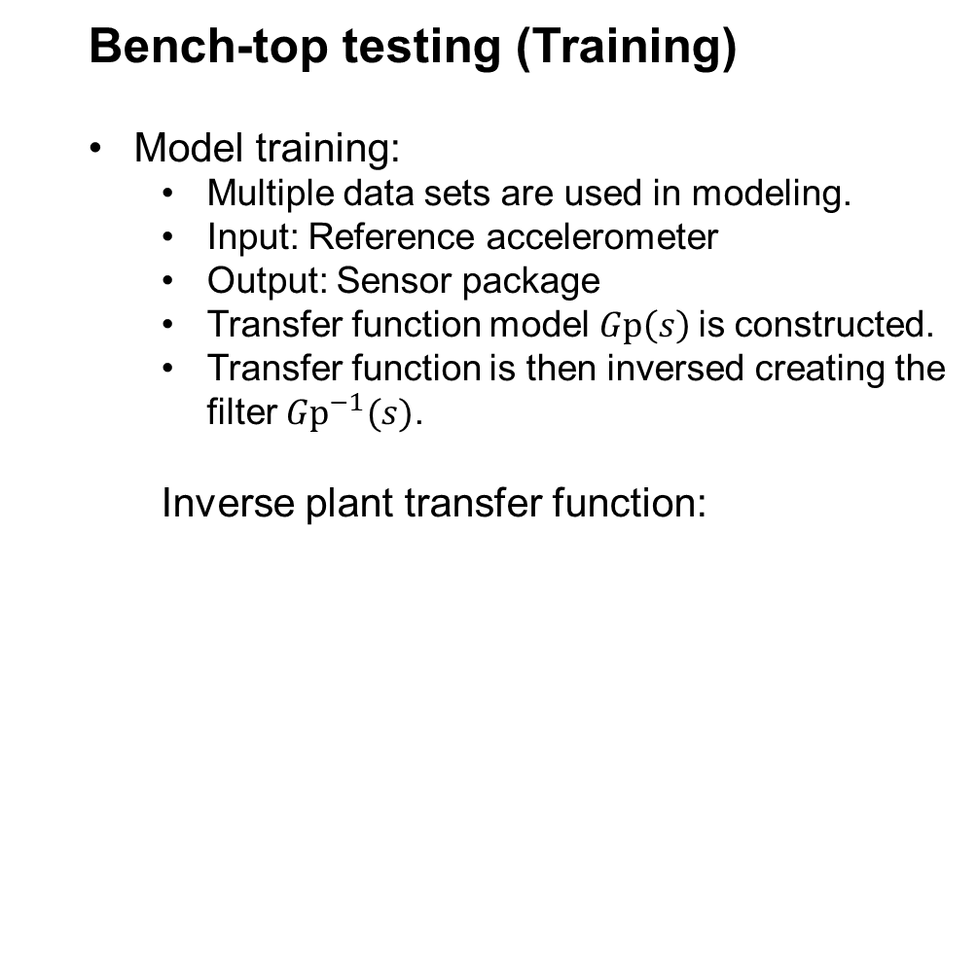
Methodology
Experimentation
Results and Discussion
Future work
Bench-top testing (Training)
Model training:
Multiple data sets are used in modeling.
Input: Reference accelerometer
Output: Sensor package
Transfer function model $Gp\left(s\right)$is constructed.
Transfer function is then inversed creating the filter${ Gp}^{−1}(s)$.
Inverse plant transfer function:
zz
12

Slide 13
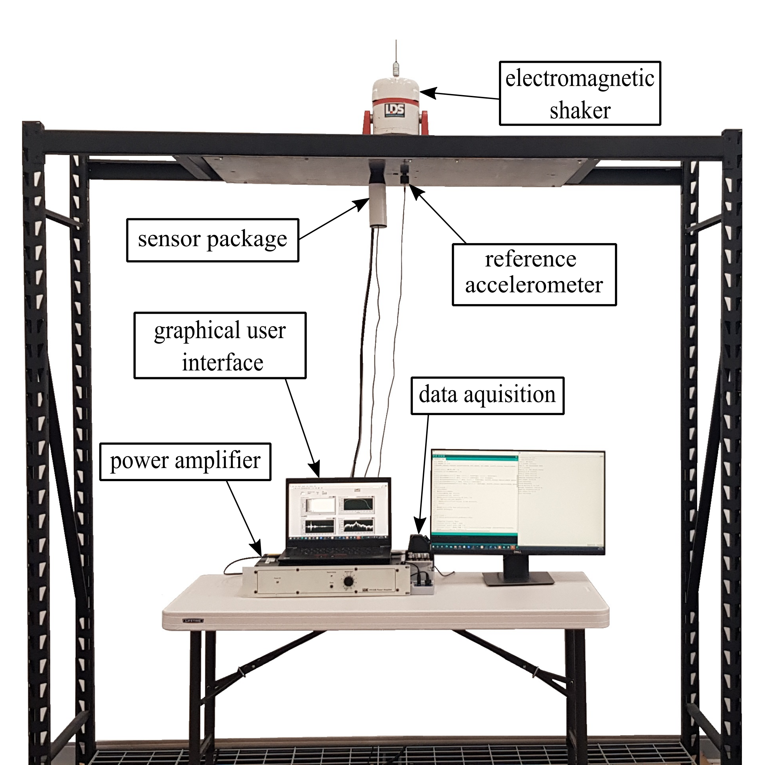
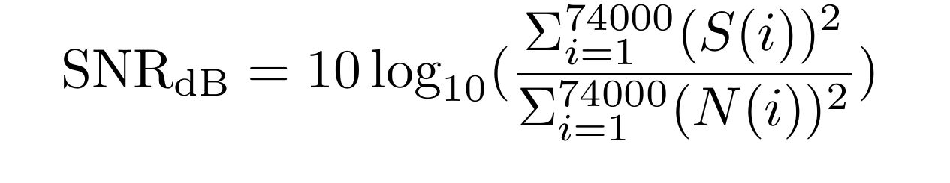
Methodology
Experimentation
Results and Discussion
Future work
Structure test (Validation)
Experimental parameters:
Steel test structure is constructed.
Data acquisition system:
Analog output generate excitation signal.
Digital trigger to synchronize sensor package and reference accelerometer.
Data logging of reference acceleration.
Signal-to-noise ration was used to measure performance.
13

Slide 14
Methodology
Experimentation
Results and Discussion
Future work
Structure test (Validation)
Experimental procedure:
The sensor package is mounted onto test structure along with a reference accelerometer.
The electromagnetic shaker is secured on top as the source of excitation.
The package and reference accelerometers are triggered.
Chirp signal is then used to excite the structure.
Sensor package data is examined with and without filtering to gauge performance.
14

Slide 15
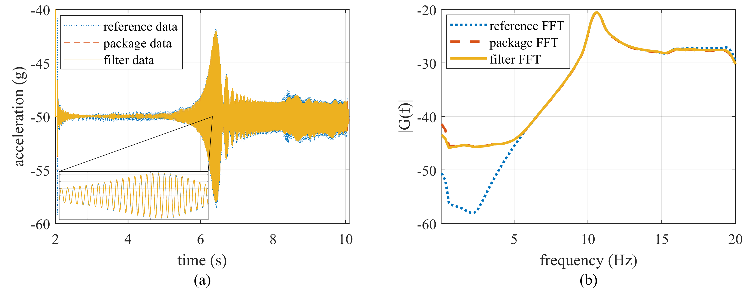
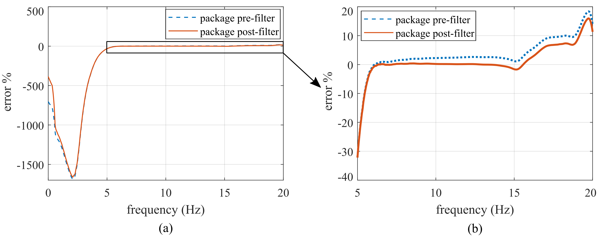
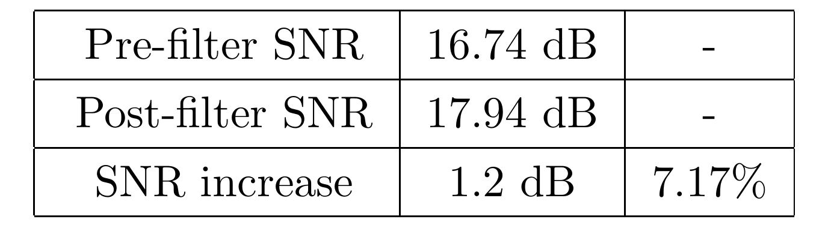
Methodology
Experimentation
Results and Discussion
Future work
Experimental outcomes
Structure test (Validation):
Filtered signal traces the reference with high correlation.
Frequency domain indicates enhancement in the range of 6-20 Hz.
Error percentage is considered negligible between 6-14 Hz (<0.4%).
Signal-to-noise ratio pre and post filtering is shown.
15

Slide 16
Methodology
Experimentation
Results and Discussion
Future work
Structure test (Validation)
Findings and limitations:
Diminishing returns of the filter can be observed in the range below 5 Hz.
Analog-to-digital converter (ADC) lack adequate resolution to detect the low-energy signal found in lower frequencies.
16

Slide 17
Methodology
Experimentation
Results and Discussion
Future work
Future work
Sensor improvement
Improve resolution of analog to digital converter onboard the sensor package.
Investigate sensor network deployment.
Edge implementation
Discretize transfer-function filter.
Investigate the feasibility of microcontroller implementation.
On-edge
$$Gp\left(z\right) { Gp}^{−1}(z)$$
17

Slide 18
Thank you
Questions?
Author Information
Name: Joud Satme
Email: Jsatme@email.sc.edu

Slide 19
References:
[1] Pakzad, S. N., Fenves, G. L., Kim, S., and Culler, D. E., “Design and implementation of scalable wireless
sensor network for structural monitoring,” Journal of Infrastructure Systems 14, 89–101 (mar 2008).
[2] Sabato, A., Niezrecki, C., and Fortino, G., “Wireless mems-based accelerometer sensor boards for structural
vibration monitoring: A review,” IEEE Sensors Journal 17(2), 226–235 (2017).
[3] Carroll, S., Satme, J., Alkharusi, S., Vitzilaios, N., Downey, A., and Rizos, D., “Drone-based vibration
monitoring and assessment of structures,” Applied Sciences 11(18) (2021).
[4] Takeuchi, K., Masuda, A., Akahori, S., Higashi, Y., and Miura, N., “A close inspection and vibration sensing
aerial robot for steel structures with an EPM-based landing device,” in [Nondestructive Characterization
and Monitoring of Advanced Materials, Aerospace, and Civil Infrastructure 2017], Wu, H. F., Gyekenyesi,
A. L., Shull, P. J., and Yu, T.-Y., eds., 10169, 666 – 677, International Society for Optics and Photonics,
SPIE (2017).
[5] Chen, B. and Liu, W., “Mobile agent computing paradigm for building a flexible structural health monitoring
sensor network,” Computer-Aided Civil and Infrastructure Engineering 25, 504–516 (aug 2010).
[6] Badri, A. E., Sinha, J. K., and Albarbar, A., “A typical filter design to improve the measured signals from
mems accelerometer,” Measurement 43(10), 1425–1430 (2010).
[7] Karpel, M. and Ricci, S., “Experimental modal analysis of large structures by substructuring,” Mechanical
Systems and Signal Processing 11(2), 245–256 (1997).
[8] Sim, S.-H., Li, J., Jo, H., Park, J.-W., Cho, S., Jr, B. F. S., and Jung, H.-J., “A wireless smart sensor
network for automated monitoring of cable tension,” Smart Materials and Structures 23, 025006 (dec 2013).
[9] Ubertini, F., Comanducci, G., and Cavalagli, N., “Vibration-based structural health monitoring of a historic bell-tower using output-only measurements and multivariate statistical analysis,” Structural Health
Monitoring 15(4), 438–457 (2016).
[10] Johnson, D. H., “Signal-to-noise ratio,” Scholarpedia 1(12), 2088 (2006). revision #126771.
[11] Ljung, L., System Identification Toolbox (2014)

